Slide 1
NSF14-43054 start October 1, 2014
Datanet: CIF21 DIBBs: Middleware and High Performance Analytics Libraries for Scalable Data Science
Indiana University (Fox, Qiu, Crandall, von Laszewski),
Rutgers (Jha)
Virginia Tech (Marathe)
Kansas (Paden)
Stony Brook (Wang)
Arizona State(Beckstein)
Utah(Cheatham)
Overview by Geoffrey Fox (PI) June 24 2015
http://news.indiana.edu/releases/iu/2014/10/big-data-dibbs-grant.shtml
http://www.nsf.gov/awardsearch/showAward?AWD_ID=1443054

Slide 2
Important Components
NIST Big Data Application Analysis – mainly from project
HPC-ABDS: Cloud-HPC interoperable software performance of HPC (High Performance Computing) and the rich functionality of the commodity Apache Big Data Stack.
  This is reservoir of software subsystems – nearly all from outside project and mix of HPC and Big Data communities
MIDAS: Integrating Middleware – from project
SPIDAL (Scalable Parallel Interoperable Data Analytics Library): Scalable Analytics for Biomolecular Simulations, Network and Computational Social Science, Epidemiology, Computer Vision, Spatial Geographical Information Systems, Remote Sensing for Polar Science and Pathology Informatics.
  Domain specific data analytics libraries – mainly from project
  Add Core Machine learning Libraries – mainly from community
  Benchmarks – project adds to community

Slide 3
Application Analysis

Slide 4
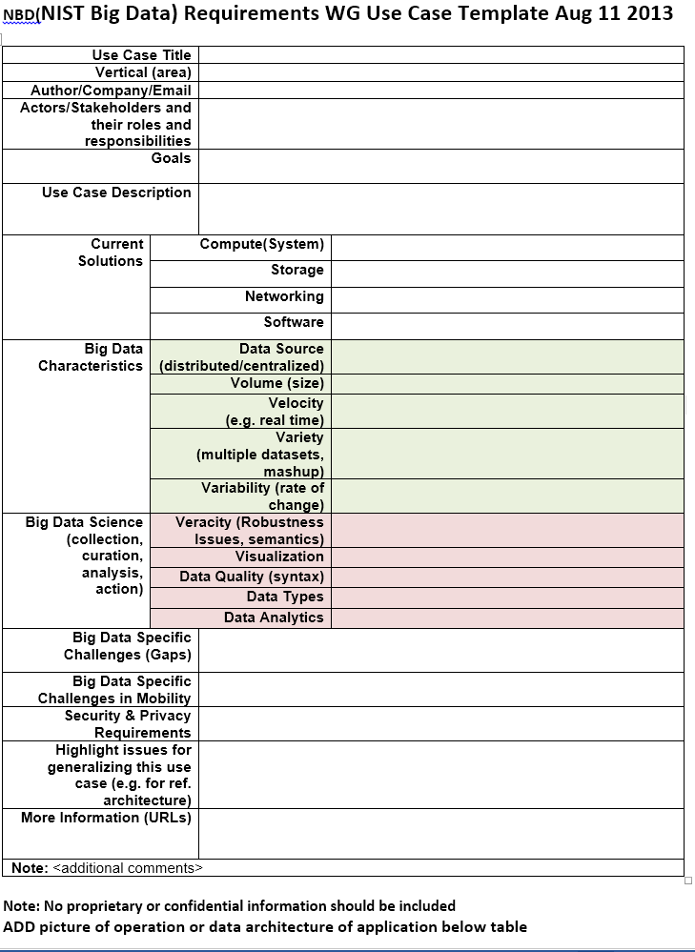
Use Case Template
26 fields completed for 51 areas
Government Operation: 4
Commercial: 8
Defense: 3
Healthcare and Life Sciences: 10
Deep Learning and Social Media: 6
The Ecosystem for Research: 4
Astronomy and Physics: 5
Earth, Environmental and Polar Science: 10
Energy: 1

Slide 5
51 Detailed Use Cases: Contributed July-September 2013
Covers goals, data features such as 3 V’s, software, hardware
26 Features for each use case
Biased to science
http://bigdatawg.nist.gov/usecases.php
https://bigdatacoursespring2014.appspot.com/course (Section 5)
Government Operation(4): National Archives and Records Administration, Census Bureau
Commercial(8): Finance in Cloud, Cloud Backup, Mendeley (Citations), Netflix, Web Search, Digital Materials, Cargo shipping (as in UPS)
Defense(3): Sensors, Image surveillance, Situation Assessment
Healthcare and Life Sciences(10): Medical records, Graph and Probabilistic analysis, Pathology, Bioimaging, Genomics, Epidemiology, People Activity models, Biodiversity
Deep Learning and Social Media(6): Driving Car, Geolocate images/cameras, Twitter, Crowd Sourcing, Network Science, NIST benchmark datasets
The Ecosystem for Research(4): Metadata, Collaboration, Language Translation, Light source experiments
Astronomy and Physics(5): Sky Surveys including comparison to simulation, Large Hadron Collider at CERN, Belle Accelerator II in Japan
Earth, Environmental and Polar Science(10): Radar Scattering in Atmosphere, Earthquake, Ocean, Earth Observation, Ice sheet Radar scattering, Earth radar mapping, Climate simulation datasets, Atmospheric turbulence identification, Subsurface Biogeochemistry (microbes to watersheds), AmeriFlux and FLUXNET gas sensors
Energy(1): Smart grid

Slide 6
51 Use Cases: What is Parallelism Over?
People: either the users (but see below) or subjects of application and often both
Decision makers like researchers or doctors (users of application)
Items such as Images, EMR, Sequences below; observations or contents of online store
  Images or “Electronic Information nuggets”
  EMR: Electronic Medical Records (often similar to people parallelism)
  Protein or Gene Sequences;
  Material properties, Manufactured Object specifications, etc., in custom dataset
  Modelled entities like vehicles and people
Sensors – Internet of Things
Events such as detected anomalies in telescope or credit card data or atmosphere
(Complex) Nodes in RDF Graph
Simple nodes as in a learning network
Tweets, Blogs, Documents, Web Pages, etc.
  And characters/words in them
Files or data to be backed up, moved or assigned metadata
Particles/cells/mesh points as in parallel simulations

Slide 7
Features of 51 Use Cases I
PP (26) “All” Pleasingly Parallel or Map Only
MR (18) Classic MapReduce MR (add MRStat below for full count)
MRStat (7) Simple version of MR where key computations are simple reduction as found in statistical averages such as histograms and averages
MRIter (23) Iterative MapReduce or MPI (Spark, Twister)
Graph (9) Complex graph data structure needed in analysis
Fusion (11) Integrate diverse data to aid discovery/decision making; could involve sophisticated algorithms or could just be a portal
Streaming (41) Some data comes in incrementally and is processed this way
Classify (30) Classification: divide data into categories
S/Q (12) Index, Search and Query

Slide 8
Features of 51 Use Cases II
CF (4) Collaborative Filtering for recommender engines
LML (36) Local Machine Learning (Independent for each parallel entity) – application could have GML as well
GML (23) Global Machine Learning: Deep Learning, Clustering, LDA, PLSI, MDS,
  Large Scale Optimizations as in Variational Bayes, MCMC, Lifted Belief Propagation, Stochastic Gradient Descent, L-BFGS, Levenberg-Marquardt . Can call EGO or Exascale Global Optimization with scalable parallel algorithm
Workflow (51) Universal
GIS (16) Geotagged data and often displayed in ESRI, Microsoft Virtual Earth, Google Earth, GeoServer etc.
HPC (5) Classic large-scale simulation of cosmos, materials, etc. generating (visualization) data
Agent (2) Simulations of models of data-defined macroscopic entities represented as agents

Slide 9

Geospatial Information System
Shared / Dedicated / Transient / Permanent
HPC Simulations
Internet of Things
Metadata/Provenance
Archived/Batched/Streaming
Data Source and Style View
10
9
8
HDFS/Lustre/GPFS
7
6
Enterprise Data Model
5
Files/Objects
SQL/NoSQL/NewSQL
4
Search / Query / Index
Local Analytics
Graph Algorithms
Micro-benchmarks
Alignment
Optimization Methodology
Learning
Classification
Streaming
Global Analytics
Linear Algebra Kernels
Recommendations
Visualization
Base Statistics
3
2
1
4 Ogre Views and 50 Facets
Execution View
Pleasingly Parallel
1
2
3
4
5
6
7
8
9
10
11
12
13
14
14
13
12
11
10
9
8
7
6
Classic MapReduce
Map-Collective
5
4
3
2
1
Map Point-to-Point
Single Program Multiple Data
Map Streaming
1
Processing View
Shared Memory
Bulk Synchronous Parallel
2
3
Performance Metrics
4
Volume
Dynamic = D / Static = S
$O\left(N^{2}\right)$ = NN / $O(N)$ = N
Velocity
Variety
Veracity
Communication Structure
Regular = R / Irregular = I
Data Abstraction
Iterative / Simple
5
Metric = M / Non-Metric = N
Flops per Byte; Memory I/O
Execution Environment; Core libraries
6
7
Fusion
Dataflow
8
Problem
Architecture
View
9
Agents
10
Workflow
11
12

Slide 10
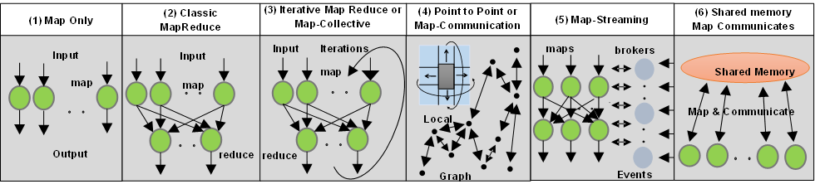
6 Forms of MapReduce cover “all” circumstances

Slide 11
Benchmarks/Mini-apps spanning Facets
Look at NSF SPIDAL Project, NIST 51 use cases, Baru-Rabl review
Catalog facets of benchmarks and choose entries to cover “all facets”
Micro Benchmarks: SPEC, EnhancedDFSIO (HDFS), Terasort, Wordcount, Grep, MPI, Basic Pub-Sub ….
SQL and NoSQL Data systems, Search, Recommenders: TPC (-C to x–HS for Hadoop), BigBench, Yahoo Cloud Serving, Berkeley Big Data, HiBench, BigDataBench, Cloudsuite, Linkbench
  includes MapReduce cases Search, Bayes, Random Forests, Collaborative Filtering
Spatial Query: select from image or earth data
Alignment: Biology as in BLAST
Streaming: Online classifiers, Cluster tweets, Robotics, Industrial Internet of Things, Astronomy; BGBenchmark; choose to cover all 5 subclasses
Pleasingly parallel (Local Analytics): as in initial steps of LHC, Pathology, Bioimaging (differ in type of data analysis)
Global Analytics: Outlier, Clustering, LDA, SVM, Deep Learning, MDS, PageRank, Levenberg-Marquardt, Graph 500 entries
Workflow and Composite (analytics on xSQL) linking above

Slide 12
HPC-ABDS
21 layer target software stack

Slide 14
http://hpc-abds.org/kaleidoscope/

Slide 15
HPC-ABDS Stack Summarized
The HPC-ABDS software is broken up into 21 layers so that one can discuss software systems in reasonable size groups.
  The layers where there is especial opportunity to integrate HPC are colored green in figure.
We note that data systems that we construct from this software can run interoperably on virtualized or non-virtualized environments aimed at key scientific data analysis problems.
Most of ABDS emphasizes scalability but not performance and one of our goals is to produce high performance environments. Here there is clear need for better node performance and support of accelerators like Xeon-Phi and GPU’s.
Figure “ABDS v. HPC Architecture” contrasts modern ABDS and HPC stacks illustrating most of the 21 layers and labelling on left with layer number used in HPC-ABDS Figure.
The omitted layers in architecture figure are Interoperability, DevOps, Monitoring and Security (layers 7, 6, 4, 3) which are all important and clearly applicable to both HPC and ABDS.
We also add an extra layer “language” not discussed in HPC-ABDS Figure.

Slide 16
MIDAS and HPC-ABDS Integration

Slide 17







High Performance Applications
Scalable Parallel Interoperable Data Analytics Library (SPIDAL) High performance Mahout, R, Matlab …..
Application Abstractions/Standards
Graphs, Networks, Images, Geospatial ..
HPC ABDS
Hourglass
HPC Yarn for Resource management
Horizontally scalable parallel programming model
Collective and Point to Point Communication
Support for iteration (in memory processing)
System Abstraction/Standards
Data Format and Storage
>~ 300 Software Subsystems
HPC ABDS SYSTEM (Middleware)

Slide 18
Applications SPIDAL MIDAS ABDS
Govt. Operations | Commercial Defense |  | Healthcare, Life Science |  |  | Deep Learning, Social Media |  | Research Ecosystems | Astronomy, Physics |  | Earth, Env., Polar Science |  | Energy
(Inter)disciplinary Workflow
Analytics Libraries
Native ABDS SQL-engines, Storm, Impala, Hive, Shark |  | Native HPC MPI |  | HPC-ABDS MapReduce
 |  |  |  | Map Only, PP Many Task |  |  | Classic MapReduce |  |  | Map Collective |  | Map – Point to Point, Graph
MIddleware for Data-Intensive Analytics and Science (MIDAS) API
Communication (MPI, RDMA, Hadoop Shuffle/Reduce, HARP Collectives, Giraph point-to-point) |  |  |  |  |  |  | Data Systems and Abstractions (In-Memory; HBase, Object Stores, other NoSQL stores, Spatial, SQL, Files)
Higher-Level Workload Management (Tez, Llama) |  |  |  |  | Workload Management (Pilots, Condor) |  |  |  |  | Framework specific Scheduling (e.g. YARN)
External Data Access (Virtual Filesystem, GridFTP, SRM, SSH) |  |  |  |  |  |  | Cluster Resource Manager (YARN, Mesos, SLURM, Torque, SGE)
Compute, Storage and Data Resources (Nodes, Cores, Lustre, HDFS)
Community & Examples
SPIDAL
Programming & Runtime Models
MIDAS
Resource Fabric

Slide 19
Applications SPIDAL MIDAS ABDS
Govt. Operations | Commercial Defense |  | Healthcare, Life Science |  |  | Deep Learning, Social Media |  | Research Ecosystems | Astronomy, Physics |  | Earth, Env., Polar Science |  | Energy
(Inter)disciplinary Workflow
Analytics Libraries
Native ABDS SQL-engines, Storm, Impala, Hive, Shark |  | Native HPC MPI |  | HPC-ABDS MapReduce
 |  |  |  | Map Only, PP Many Task |  |  | Classic MapReduce |  |  | Map Collective |  | Map – Point to Point, Graph
MIddleware for Data-Intensive Analytics and Science (MIDAS) API
Communication (MPI, RDMA, Hadoop Shuffle/Reduce, HARP Collectives, Giraph point-to-point) |  |  |  |  |  |  | Data Systems and Abstractions (In-Memory; HBase, Object Stores, other NoSQL stores, Spatial, SQL, Files)
Higher-Level Workload Management (Tez, Llama) |  |  |  |  | Workload Management (Pilots, Condor) |  |  |  |  | Framework specific Scheduling (e.g. YARN)
External Data Access (Virtual Filesystem, GridFTP, SRM, SSH) |  |  |  |  |  |  | Cluster Resource Manager (YARN, Mesos, SLURM, Torque, SGE)
Compute, Storage and Data Resources (Nodes, Cores, Lustre, HDFS)
Community & Examples
SPIDAL
Programming & Runtime Models
MIDAS
Resource Fabric

Slide 20
Data Analytics identified in proposal

Slide 21
Machine Learning in Network Science, Imaging in Computer Vision, Pathology, Polar Science, Biomolecular Simulations
Algorithm | Applications | Features | Status | Parallelism
Graph Analytics
Community detection | Social networks, webgraph | Graph . | P-DM | GML-GrC
Subgraph/motif finding | Webgraph, biological/social networks |  | P-DM | GML-GrB
Finding diameter | Social networks, webgraph |  | P-DM | GML-GrB
Clustering coefficient | Social networks |  | P-DM | GML-GrC
Page rank | Webgraph |  | P-DM | GML-GrC
Maximal cliques | Social networks, webgraph |  | P-DM | GML-GrB
Connected component | Social networks, webgraph |  | P-DM | GML-GrB
Betweenness centrality | Social networks | Graph, Non-metric, static | P-Shm | GML-GRA
Shortest path | Social networks, webgraph |  | P-Shm
Spatial Queries and Analytics
Spatial relationship based queries | GIS/social networks/pathology informatics | Geometric | P-DM | PP
Distance based queries |  |  | P-DM | PP
Spatial clustering |  |  | Seq | GML
Spatial modeling |  |  | Seq | PP
GML Global (parallel) ML
GrA Static GrB Runtime partitioning

Slide 22
Some specialized data analytics in SPIDAL
Algorithm | Applications | Features | Status | Parallelism
Core Image Processing
Image preprocessing | Computer vision/pathology informatics | Metric Space Point Sets, Neighborhood sets & Image features | P-DM | PP
Object detection & segmentation |  |  | P-DM | PP
Image/object feature computation |  |  | P-DM | PP
3D image registration |  |  | Seq | PP
Object matching |  | Geometric | Todo | PP
3D feature extraction |  |  | Todo | PP
Deep Learning
Learning Network, Stochastic Gradient Descent | Image Understanding, Language Translation, Voice Recognition, Car driving | Connections in artificial neural net | P-DM | GML
aa
PP Pleasingly Parallel (Local ML)
Seq Sequential Available
GRA Good distributed algorithm needed
Todo No prototype Available
P-DM Distributed memory Available
P-Shm Shared memory Available

Slide 23
Some Core Machine Learning Building Blocks
Algorithm | Applications | Features | Status | //ism
DA Vector Clustering | Accurate Clusters | Vectors | P-DM | GML
DA Non metric Clustering | Accurate Clusters, Biology, Web | Non metric, O(N²) | P-DM | GML
Kmeans; Basic, Fuzzy and Elkan | Fast Clustering | Vectors | P-DM | GML
Levenberg-Marquardt Optimization | Non-linear Gauss-Newton, use in MDS | Least Squares | P-DM | GML
SMACOF Dimension Reduction | DA- MDS with general weights | Least Squares, O(N²) | P-DM | GML
Vector Dimension Reduction | DA-GTM and Others | Vectors | P-DM | GML
TFIDF Search | Find nearest neighbors in document corpus | Bag of “words” (image features) | P-DM | PP
All-pairs similarity search | Find pairs of documents with TFIDF distance below a threshold
 |  |  | Todo | GML
Support Vector Machine SVM | Learn and Classify | Vectors | Seq | GML
Random Forest | Learn and Classify | Vectors | P-DM | PP
Gibbs sampling (MCMC) | Solve global inference problems | Graph | Todo | GML
Latent Dirichlet Allocation LDA with Gibbs sampling or Var. Bayes | Topic models (Latent factors) | Bag of “words” | P-DM | GML
Singular Value Decomposition SVD | Dimension Reduction and PCA | Vectors | Seq | GML
Hidden Markov Models (HMM) | Global inference on sequence models | Vectors | Seq | PP & GML

Slide 24
Timeline

Slide 25
 | Year 1 | Year 2 | Years 3-5
SPIDAL | Community requirement and technology evaluation | SPIDAL-MIDAS Interface and SPIDAL V1.0 | Integrated testing with Algorithms & MIDAS. Extend to V2.0
MIDAS | (i) Arch and design spec (ii) In-memory pilot abstract., integrate with XSEDE | SPIDAL scheduling components and execution proceesing. MIDAS on Blue Waters. V1.0 release | Scalability testing, adaptors for new platforms, Support for tools and developers, Optimization, Phase II of execution-processing models,V2.0
Community: HPC Biomolecular Simulations | Community requirements gathering | CPPTRAJ to integrate with MIDAS for ensemble analysis on Blue Waters | (i) Parallel Trajectory and MDAnalysis with MR (ii) iBIOMES data mgmt. in MIDAS (iii) End-to-end Integration of CPPTraj-MIDAS with SPIDAL (iv) Use SPIDAL Kmeans (v) Tutorials and outreach
Community: Network Science and Comp. Social Science | i) Gather community requirement ii) study existing network analytic algorithms | i) Giraph-based clustering and community detection problems ii) Integ of CINET in SPIDAL | i) Algorithm implementation for subgraph problems ii) Develop new algorithms as necessary
Community: Computational Epidemiology | Community requirement gathering | Design i) Wrapper for EpiSimdemics and EpiFast ii) Giraph simulation tool | i) Implement the wrappers ii) Start implementing Giraph-based tool iii) Integrate EpiSimdemics and Epifast with SPIDAL
Community: Spatial | Community reqs Spatial queries library and 2D parallel | spatial 2D clustering and Geospatial & pathology apps | (i) Implementation of 3D spatial queries. (ii) Application to 3D pathology
Community: Pathology | (i) Implementation of 2D image preproc., segment and feature extraction and tumor research | Image registration, object matching & feature extraction (3D) Integrate MIDAS | Continued implementation of 3D image processing library Application to liver and neuroblastoma
Community: Computer vision: | Port image processing, feature extraction, image matching, pleasingly parallel ML algos | Implement ML and optimization algorithms; large-scale image recognition | Continue implementing ML and global optimization; large-scale 3D recognition in social images
Community: Radar informatics: | single-echogram layer finding, tile matching | (i) Develop and implement continent-scale layer finding | Develop and implement (i) change detection and (ii) flow field estimation in satellite images.

Slide 26
Compute Systems

Slide 27
Relevant DSC and XSEDE Computing Systems
DSC adding128 node Haswell based (2 chips, 24 or 36 cores per node) system (Juliet) (arrived June 19)
  128 GB memory per node
  Substantial conventional disk per node (8TB) plus PCI based 400 GB SSD
  Infiniband with SR-IOV
  Back end Lustre or equivalent hosted on Echo
DSC Older or Very Old (tired) machines
  India (128 nodes, 1024 cores), Bravo (16 nodes, 128 cores), Delta(16 nodes, 192 cores), Echo(16 nodes, 192 cores), Tempest (32 nodes, 768 cores); some with large memory, large disk and GPU
  Optimized for Cloud research and Large scale Data analytics exploring storage models, algorithms
  Bare-metal v. Openstack virtual clusters
  Extensively used in Education
  Bravo set up as an Hadoop Cluster
XSEDE – Wrangler Blue Waters and Comet likely to be especially useful

